Slide 1
Probability And Statistics
Samarjit Das
Indian Statistical Institute, Kolkata

Slide 2

Do You Know ?????

Slide 3
Prasanta Chandra Mahalanobis FRS (29 June 1893 – 28 June 1972)
Founding Father of Modern day Statistics in India.
He established ISI (Indian Statistical Institute) Kolkata.
ISI, Kolkata is regarded as one of the world capital of Statistics.
He has many fundamental work in statistics, One particular is the salt survey. He is the father of Large Scale Survey sampling.

Slide 4
Salt survey
Here statistical thinking came to their rescue. If R, P, and S are the amounts quoted by the contractors of rice, pulses and salt, and r, p, and s are the per capita consumptions of these commodities as estimated from household surveys, they argued that R/r, P/p and S/s are estimates of the same number of persons. Based on the figures quoted by the contractors, the three estimates based on rice, pulses and salt were, 30,253, 21,122, and 10,891 respectively. They chose the smallest number based on salt. Rice was the most expensive commodity at that time and apparently the contractors were over quoting the amount of rice purchased to make money.

Slide 5
Salt survey for Red Fort Case
His estimate was 10,891 .
Actual was 10,887.
Estimate is not exact, quite close and but useful.
Statistic is not an exact science like physics, Chemistry, math etc
It is an science of approximation.

Slide 6
Syllabus
Probability: Concept of experiments, sample space, event. Definition of Combinatorial Probability. Conditional Probability, Bayes Theorem. Probability distributions: discrete& continuous distributions, Binomial, Poisson & Geometric distributions, Uniform, Exponential, Normal, Chi-square, t, F distributions. Expected values & moments: mathematical expectation & its properties, Moments (including variance) & their properties, Moment generating function. (15 hours)
Introduction to Statistics: Definition of Statistics. Basic objectives. Applications in various branches of science with examples. Collection of Data: Internal and external data, Primary and secondary Data. Population and sample, Representative sample. Descriptive Statistics: Classification and tabulation of univariate data, graphical representation, Frequency curves. Descriptive measures - central tendency and dispersion. Bivariate data. Summarization, marginal and conditional frequency distribution. Scatter diagram. Linear regression and correlation. Least squares method. Rank correlation. (20 hours)
Sampling Techniques: Random sampling. Sampling from finite and infinite populations. Estimates and standard error (sampling with replacement and sampling without replacement), Sampling distribution of sample mean, stratified random sampling (5 hours)

Slide 7
Books
Text Books: 1. Introduction of Probability models. By S. M. Ross
2. Fundamentals of Statistics (vol. I and vol. II) - A. Goon, M. Gupta and B. Dasgupta.
Reference Books:
A first course in Probability, S.M. Ross.
Probability and Statistics for Engineers (4th Edition) - I.R. Miller, J.E. Freund and R. Johnson.
Statistical Concepts & Methods - G.K. Bhattacharyya and R.A. Johnson.
Introduction to the Theory of Statistics - A.M. Mood, F.A. Graybill & D.C. Boes.

Slide 8
Reference for Topics
Probability: Chapter 1 and 2 from S.M. Ross Book (text book); Chapter 3 of GGD, Volume 1; and Chapter 1, 2, 3 of MGB.
Statistics: Chapter 4,5,6,7,8 , 11, 13 of GGD, vol1.;
Chapter 1 and 2 of I.R. Miller, J.E. Freund and R. Johnson.
Sampling: Chapter 21 of GGD.

Slide 9
History
The word statistik comes from Italian word statistia which means "statesman".
First used by Gottfried Achenwall (1719–72).
Long before the 18th century, people had been recording and using data.
Official government statistics are as old as recorded history.
The old testaments contain several accounts of census taking.
Kautilya’s Arthashastra (321-296) B.C.) contains detailed discussion on collection, preservation , tabulation, interpretation of data on agriculture, population, taxes, business both for urban and rural India.

Slide 10
What is Statistics?
• Statistics is a mathematical science, but it is
not a branch of mathematics.
• Statistics is the science of data.
• Statistics is a science that deals with the study of how to collect, classify, summarize, organize, analyze, interpret, and present data.

Slide 11
What is statistics?
A branch of mathematics taking and transforming numbers into useful information for decision makers
Methods for processing & analyzing numbers
Methods for helping reduce the uncertainty inherent in decision making

Slide 12
Why Study Statistics?
Decision Makers Use Statistics To:
Statistics helps in providing a better understanding and exact description of a phenomenon of nature.
Statistics helps in proper and efficient planning of a statistical inquiry in any field of study.
Statistical helps in collecting an appropriate quantitative data.
Statistics helps in presenting complex data in a suitable tabular, diagrammatic and graphic form for an easy and clear comprehension of the data.
Statistics helps in understanding the nature and pattern of variability of a phenomenon through quantitative observations.
Statistics helps in drawing valid inference, along with a measure of their reliability about the population parameters from the sample data.
Draw conclusions about large groups of individuals or items, using information collected from subsets of the individuals or items.
Make reliable forecasts about a business activity
Improve business processes

Slide 13
Fields of Applications of Statistics
Actuarial science is the discipline that applies mathematical and statistical methods to assess risk in the insurance and finance industries.
Astrostatistics is the discipline that applies statistical analysis to the understanding of astronomical data.
Biostatistics is a branch of biology that studies biological phenomena and observations by means of statistical analysis, and includes medical statistics.
Business analytics is a rapidly developing business process that applies statistical methods to data sets (often very large) to develop new insights and understanding of business performance & opportunities
Chemometrics is the science of relating measurements made on a chemical system or process to the state of the system via application of mathematical or statistical methods.
Demography is the statistical study of all populations. It can be a very general science that can be applied to any kind of dynamic population, that is, one that changes over time or space.
Econometrics is a branch of economics that applies statistical methods to the empirical study of economic theories and relationships.
Environmental statistics is the application of statistical methods to environmental science. Weather, climate, air and water quality are included, as are studies of plant and animal populations.
Epidemiology is the study of factors affecting the health and illness of populations, and serves as the foundation and logic of interventions made in the interest of public health and preventive medicine.
Geostatistics is a branch of geography that deals with the analysis of data from disciplines such as petroleum geology, hydrogeology, hydrology, meteorology, oceanography, geochemistry, geography.

Slide 14
Fields of Applications of Statistics
Operations research (or Operational Research) is an interdisciplinary branch of applied mathematics and formal science that uses methods such as mathematical modeling, statistics, and algorithms to arrive at optimal or near optimal solutions to complex problems.
Population ecology is a sub-field of ecology that deals with the dynamics of species populations and how these populations interact with the environment.
Psychometric is the theory and technique of educational and psychological measurement of knowledge, abilities, attitudes, and personality traits.
Quality control reviews the factors involved in manufacturing and production; it can make use of statistical sampling of product items to aid decisions in process control or in accepting deliveries.
Quantitative psychology is the science of statistically explaining and changing mental processes and behaviors in humans.
Reliability Engineering is the study of the ability of a system or component to perform its required functions under stated conditions for a specified period of time
Statistical finance, an area of econophysics, is an empirical attempt to shift finance from its normative roots to a positivist framework using exemplars from statistical physics with an emphasis on emergent or collective properties of financial markets.
Statistical mechanics is the application of probability theory, which includes mathematical tools for dealing with large populations, to the field of mechanics, which is concerned with the motion of particles or objects when subjected to a force.
Statistical physics is one of the fundamental theories of physics, and uses methods of probability theory in solving physical problems.
Statistical Signal Processing
Statistical thermodynamics is the study of the microscopic behaviors of thermodynamic systems using probability theory and provides a molecular level interpretation of thermodynamic quantities such as work, heat, free energy, and entropy.

Slide 15
Statistics
Descriptive Statistics
Inferential Statistics

Slide 16
Descriptive statistics: The goal is to the organization, summarization, and presentation of data.
Inferential statistics: The objective is to make reasonable guesses about population characteristics using sample data.
Average, spread, range, frequency, histogram, median, scatter plot, mode, interquartile range,…
Hypothesis test, z. ANOVA, confidence interval, ordinary least squares, ², margin of error, t, …

Slide 17
TERMINOLOGY
Individuals or Units or Cases or Experimental units
are objects being described by a set of data (for example, people, households, cars, animals, corn, etc.).
Population is the entire group of individuals about which we want information (for example, all students at IUPUI).
Note: Population size is denoted by N.
Sample is a representative part of the population(for example, a representative group of students at IUPUI).
Note: Sample size is denoted by n.
Variables are characteristics of the individuals that can be
measured (for example, height, yield, length, age, eye color, etc.).

Slide 18
Population vs. Sample
Population
Sample
Measures used to describe the population are called parameters
Measures computed from sample data are called statistics

Slide 19
Examples of Populations
Names of all registered voters in the United States
Incomes of all families living in Delhi
Annual returns of all stocks traded on the New York Stock Exchange
Grade point averages of all the students in your Institute

Slide 20
Random Sampling
Simple random sampling is a procedure in which
each member of the population is chosen strictly by chance,
each member of the population is equally likely to be chosen,
and
every possible sample of n objects is equally likely to be chosen
The resulting sample is called a random sample

Slide 21
Why Collect Data?
A marketing research analyst needs to assess the effectiveness of a new television advertisement.
A pharmaceutical manufacturer needs to determine whether a new drug is more effective than those currently in use.
An operations manager wants to monitor a manufacturing process to find out whether the quality of the product being manufactured is conforming to company standards.
An auditor wants to review the financial transactions of a company in order to determine whether the company is in compliance with generally accepted accounting principles.

Slide 22
Sources of Data
Primary Sources: The data collector is the one using the data for analysis
Data from a political survey
Data collected from an experiment
Observed data
Secondary Sources: The person performing data analysis is not the data collector
Analyzing census data
Examining data from print journals or data published on the internet.

Slide 23
Types of Variables
Categorical (qualitative) variables have values that can only be placed into categories, such as “yes” and “no.”
Numerical (quantitative) variables have values that represent quantities.

Slide 24
Types of Data
Data
Categorical
Numerical
Discrete
Continuous
Examples:
Marital Status
Political Party
Eye Color
(Defined categories)
Examples:
Number of Children
Defects per hour
(Counted items)
Examples:
Weight
Voltage
(Measured characteristics)

Slide 25
Measurement Levels
Differences between measurements, true zero exists
Ratio Data
Quantitative Data
Differences between measurements but no true zero
Interval Data
Ordered Categories (rankings, order, or scaling)
Ordinal Data
Qualitative Data
Categories (no ordering or direction)
Nominal Data

Slide 26
Variable
Categorical or Qualitative variable
(hair color, race, gender, etc.)
Numerical or Quantitative Variable
(age, height, weight, etc.)
Nominal
(blood types)
Ordinal
(class grades)
Discrete
(number of babies born in a hospital per day)
Continuous
(age, exam score)
Interval
(temperature ⁰C)
Ratio
(salary)

Slide 27
Categorical or Qualitative variables variables place an individual into one of several groups or categories. For example, hair color, race, gender, etc.
Numerical or Quantitative Variables that are measured in terms of numbers. For example, age, height, weight, etc.
Nominal – level of measurement that applies to data that consist of names, labels, or categories (with no implied criteria by which the data can be ordered). For example,
Color: Red Blue Green Yellow etc.
Gender: Male Female
Ordinal – level of measurement that applies to data that may be arranged in order. However, differences between data values cannot be determined or are meaningless. For examples:
Ratings: Bad, Poor, Average, Good, Excellent
Income Bracket: Low Lower Middle, Middle, Upper Middle, High

Slide 28
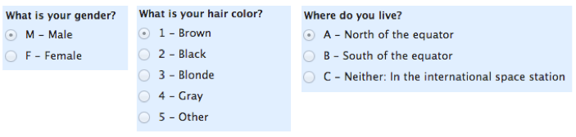


Slide 29
Discrete Variables that can only have whole numbers. Whole numbers are called integers. For example, number of babies born in a hospital per day, the number of wires in a cable, the number of people in a group or the number of rings of bark in a tree.
Continuous variables that can take on any of a range of values, such as the distance between two towns, where any value may be recorded, including fractions. There are no clear cut or sharp breaks between possible values. For example, age, length, weight, and time, and the points on a line.
Interval – level of measurement that applies to data that can be arranged in order and differences between data values are meaningful. For example, temperature (⁰F), IQ, etc.)
Ratio – level of measurement that applies to data that can be arranged in order, and both differences between data values and ratios of data values are meaningful. Data have a true zero. For example, the Kelvin scale of temperature, monthly salary, etc.)

Slide 30
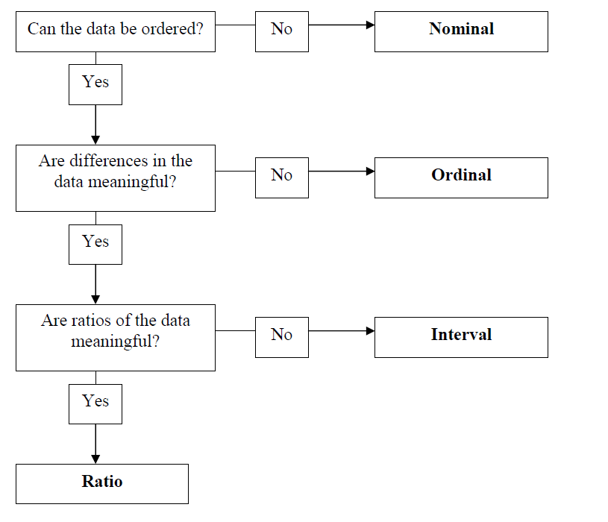

Slide 31
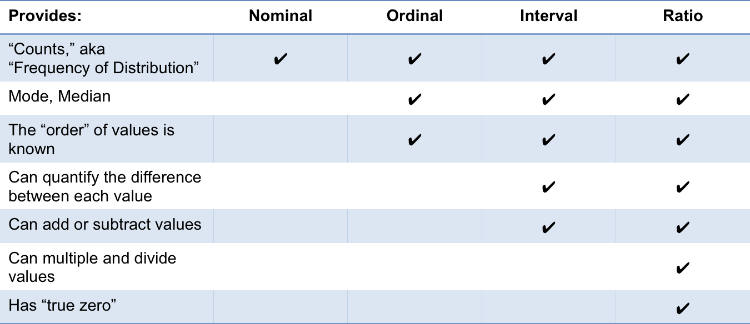

Slide 32
Data for Business Statistics
Ordinal Data
Data that is ranked or ordered according to some relationship with one another
No fixed units of measurement
Examples:
- college football rankings
- survey responses
(poor, average, good, very good, excellent)

Slide 33
Graphical Presentation of Data
Data in raw form are usually not easy to use for decision making
Some type of organization is needed
Table
Graph
The type of graph to use depends on the variable being summarized

Slide 34
Graphical Presentation of Data
(continued)
Categorical
Variables
Numerical
Variables
Frequency distribution
Bar chart
Pie chart
Pareto diagram
Line chart
Frequency distribution
Histogram and ogive
Scatter plot

Slide 35
Tables and Graphs for Categorical Variables
Categorical Data
Tabulating Data
Graphing Data
Frequency Distribution Table
Bar Chart
Pie Chart
Pareto Diagram

Slide 36
Describing Data Sets
Qualitative Data are nonnumerical
Major Discipline
Political Party
Gender
Eye color
Summarized in two ways:
Class Frequency
Class Relative Frequency

Slide 37
Class
A class is one of the categories into which qualitative data can be classified
Class Frequency
Class frequency is the number of observations in the data set that fall into a particular class
Frequency Distribution
It is a summary technique that organizes data into classes and provides in tabular form a list of the classes along with the number of observations in each class.

Slide 38
Example: Adult Aphasia
Table: Data on 22 Adult Aphasias
Subject | Type of Aphasia | Subject | Type of Aphasia
1 | Broca’s | 12 | Broca’s
2 | Anomic | 13 | Anomic
3 | Anomic | 14 | Broca’s
4 | Conduction | 15 | Anomic
5 | Broca’s | 16 | Anomic
6 | Conduction | 17 | Anomic
7 | Conduction | 18 | Conduction
8 | Anomic | 19 | Broca’s
9 | Conduction | 20 | Anomic
10 | Anomic | 21 | Conduction
11 | Conduction | 22 | Anomic

Slide 39
Table: Frequency Distribution of Data on 22 Adult
Aphasias
Type of Aphasia | Frequency
Anomic | 10
Broca’s | 5
Conduction | 7
Total | 22

Slide 40
Class Relative Frequency
Class frequency divided by the total number of observations in the data set
Class Percentage
Class relative frequency multiplied by 100

Slide 41
Table: Frequency, relative frequency, and class percentage on 22 Adult Aphasias
Type of Aphasia | Frequency | Relative Frequency | Class Percentage
Anomic | 10 | 10/22 = .455 | 45.5%
Broca’s | 5 | 5/22 = .227 | 22.7%
Conduction | 7 | 7/22 = .318 | 31.8%
Total | 22 | 22/22 = 1.00 | 100%

Slide 42
Graphical methods for describing Qualitative variables
Pie chart
Bar Chart
Pareto diagram

Slide 43
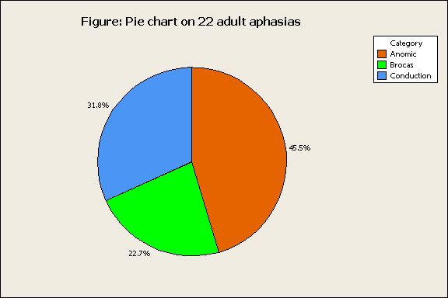
Pie Chart
A graph that displays data in a circular format.
The categories of the qualitative variable are represented by the slices of a pie.
Each slice of a pie represents a portion or percentage of the total.

Slide 44
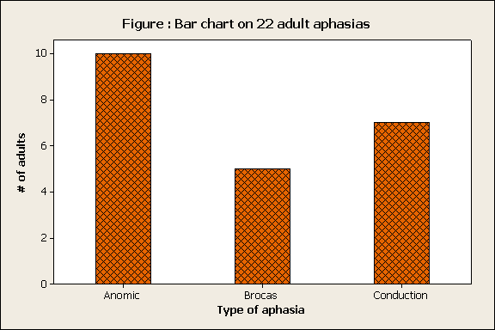
Bar Chart
A graphical representation of information in the form of bars.
Bars of equal width are drawn to represent different categories, with the length of each bar being proportional to the number or frequency of occurrence of each category.

Slide 45
Pareto Diagram
It is a special type of bar chart where the values being plotted are arranged in descending order.
The purpose is to highlight the most important among a (typically large) set of factors. That is, to separate the significant aspects of a problem from the trivial ones.
It is a popular graphical tool in process and quality control, where the heights of the bars often represent frequencies of problems (e.g., defects, accidents, breakdowns, and failures) in the production process.

Slide 46
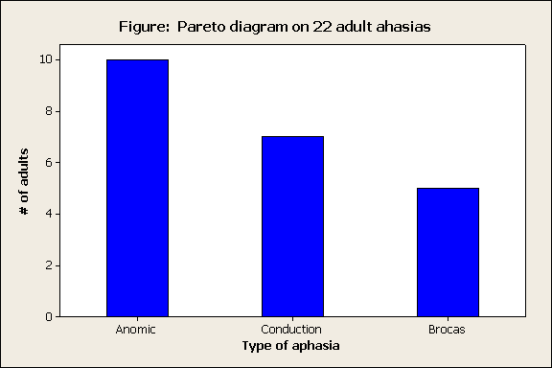

Slide 47
The Frequency Distribution Table
Summarize data by category
Example: Hospital Patients by Unit
Hospital Unit Number of Patients
Cardiac Care 1,052
Emergency 2,245
Intensive Care 340
Maternity 552
Surgery 4,630
(Variables are
categorical)

Slide 48
Bar and Pie Charts
Bar charts and Pie charts are often used for qualitative (category) data
Height of bar or size of pie slice shows the frequency or percentage for each category

Slide 49
Bar Chart Example
Hospital Number
Unit of Patients
Cardiac Care 1,052
Emergency 2,245
Intensive Care 340
Maternity 552
Surgery 4,630

Slide 50
Pie Chart Example
Hospital Number % of
Unit of Patients Total
Cardiac Care 1,052 11.93
Emergency 2,245 25.46
Intensive Care 340 3.86
Maternity 552 6.26
Surgery 4,630 52.50
(Percentages are rounded to the nearest percent)

Slide 51
Pareto Diagram
Used to portray categorical data
A bar chart, where categories are shown in descending order of frequency
A cumulative polygon is often shown in the same graph
Used to separate the “vital few” from the “trivial many”

Slide 52
Pareto Diagram Example
Example: 400 defective items are examined
for cause of defect:
Source of Manufacturing Error | Number of defects
Bad Weld | 34
Poor Alignment | 223
Missing Part | 25
Paint Flaw | 78
Electrical Short | 19
Cracked case | 21
Total | 400

Slide 53
Pareto Diagram Example
(continued)
Step 1: Sort by defect cause, in descending order
Step 2: Determine % in each category
Source of Manufacturing Error | Number of defects | % of Total Defects
Poor Alignment | 223 | 55.75
Paint Flaw | 78 | 19.50
Bad Weld | 34 | 8.50
Missing Part | 25 | 6.25
Cracked case | 21 | 5.25
Electrical Short | 19 | 4.75
Total | 400 | 100%

Slide 54
Pareto Diagram Example
(continued)
Step 3: Show results graphically
% of defects in each category (bar graph)
cumulative % (line graph)

Slide 55
Graphs to Describe Numerical Variables
Numerical Data
Frequency Distributions and
Cumulative Distributions
Histogram
Ogive

Slide 56
Sturge Rule

Slide 57
Why Use Frequency Distributions?
A frequency distribution is a way to summarize data
The distribution condenses the raw data into a more useful form...
and allows for a quick visual interpretation of the data

Slide 58
Class Intervals and Class Boundaries
Each class grouping has the same width
Determine the width of each interval by
Use at least 5 but no more than 15-20 intervals
Intervals never overlap
Round up the interval width to get desirable interval endpoints

Slide 59
Frequency Distribution Example
Example: A manufacturer of insulation randomly selects 20 winter days and records the daily high temperature
24, 35, 17, 21, 24, 37, 26, 46, 58, 30,
32, 13, 12, 38, 41, 43, 44, 27, 53, 27

Slide 60
Frequency Distribution Example
(continued)
Sort raw data in ascending order: 12, 13, 17, 21, 24, 24, 26, 27, 27, 30, 32, 35, 37, 38, 41, 43, 44, 46, 53, 58
Find range: 58 - 12 = 46
Select number of classes: 5 (usually between 5 and 15)
Compute interval width: 10 (46/5 then round up)
Determine interval boundaries: 10 but less than 20, 20 but less than 30, . . . , 60 but less than 70
Count observations & assign to classes

Slide 61
Frequency Distribution Example
(continued)
Data in ordered array:
12, 13, 17, 21, 24, 24, 26, 27, 27, 30, 32, 35, 37, 38, 41, 43, 44, 46, 53, 58
Relative
Frequency
Interval Frequency
Percentage
10 but less than 20 3 .15 15
20 but less than 30 6 .30 30
30 but less than 40 5 .25 25
40 but less than 50 4 .20 20
50 but less than 60 2 .10 10
Total 20 1.00 100

Slide 62
Histogram
A graph of the data in a frequency distribution is called a histogram
The interval endpoints are shown on the horizontal axis
the vertical axis is either frequency, relative frequency, or percentage
Bars of the appropriate heights are used to represent the number of observations within each class

Slide 63
Histogram Example
Interval
Frequency
10 but less than 20 3
20 but less than 30 6
30 but less than 40 5
40 but less than 50 4
50 but less than 60 2
(No gaps between bars)
0 10 20 30 40 50 60 70
Temperature in Degrees

Slide 64
Questions for Grouping Data into Intervals
1. How wide should each interval be? (How many classes should be used?)
2. How should the endpoints of the intervals be determined?
Often answered by trial and error, subject to user judgment
The goal is to create a distribution that is neither too "jagged" nor too "blocky”
Goal is to appropriately show the pattern of variation in the data

Slide 65
How Many Class Intervals?
Many (Narrow class intervals)
may yield a very jagged distribution with gaps from empty classes
Can give a poor indication of how frequency varies across classes
Few (Wide class intervals)
may compress variation too much and yield a blocky distribution
can obscure important patterns of variation.
(X axis labels are upper class endpoints)

Slide 66
The Cumulative Frequency Distribuiton
Data in ordered array:
12, 13, 17, 21, 24, 24, 26, 27, 27, 30, 32, 35, 37, 38, 41, 43, 44, 46, 53, 58
Cumulative Frequency
Cumulative Percentage
Class
Frequency
Percentage
10 but less than 20 3 15 3 15
20 but less than 30 6 30 9 45
30 but less than 40 5 25 14 70
40 but less than 50 4 20 18 90
50 but less than 60 2 10 20 100
Total 20 100

Slide 67
The Ogive Graphing Cumulative Frequencies
Upper interval endpoint
Cumulative Percentage
Interval
Less than 10 10 0
10 but less than 20 20 15
20 but less than 30 30 45
30 but less than 40 40 70
40 but less than 50 50 90
50 but less than 60 60 100
Interval endpoints

Slide 68
Relationships Between Variables
Graphs illustrated so far have involved only a single variable
When two variables exist other techniques are used:
Categorical
(Qualitative)
Variables
Numerical
(Quantitative)
Variables
Cross tables
Scatter plots

Slide 69
Scatter Diagrams
Scatter Diagrams are used for paired observations taken from two numerical variables
The Scatter Diagram:
one variable is measured on the vertical axis and the other variable is measured on the horizontal axis

Slide 70
Scatter Diagram Example
Volume per day | Cost per day
23 | 125
26 | 140
29 | 146
33 | 160
38 | 167
42 | 170
50 | 188
55 | 195
60 | 200

Slide 71
Describing Data Numerically
Describing Data Numerically
Central Tendency
Variation
Arithmetic Mean
Range
Median
Interquartile Range
Mode
Variance
Standard Deviation
Coefficient of Variation

Slide 72
Summary Definitions
The central tendency is the extent to which all the data values group around a typical or central value.
The variation is the amount of dispersion, or scattering, of values

Slide 73
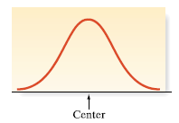
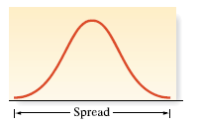
Summarizing Data Sets
Numerical Measures of Central Tendency
Central tendency is the value
or values around which the data
tend to cluster
Variability shows how strongly
the data cluster around that (those)
value(s)

Slide 74
Measures of Central Tendency: The Mean
The arithmetic mean (often just called “mean”) is the most common measure of central tendency
For a sample of size n:
Pronounced x-bar
The i^{th} value
Sample size
Observed values

Slide 75
Measures of Central Tendency: The Mean
(continued)
The most common measure of central tendency
Mean = sum of values divided by the number of values
Affected by extreme values (outliers)
0 1 2 3 4 5 6 7 8 9 10
0 1 2 3 4 5 6 7 8 9 10
Mean = 3
Mean = 4

Slide 76
CHAPTER 2
Example: During a two week period 10 houses were sold in Fancytown.
The “average” or mean price for this sample of 10 houses in Fancytown is $295,000

Slide 77
CHAPTER 2
Example: During a two week period 10 houses were sold in
Lowtown.
The “average” or mean price for this sample of 10 houses in Lowtown is $295,000
Outlier

Slide 78
Measures of Central Tendency: The Median
In an ordered array, the median is the “middle” number (50% above, 50% below)
Not affected by extreme values
0 1 2 3 4 5 6 7 8 9 10
0 1 2 3 4 5 6 7 8 9 10
Median = 3
Median = 3

Slide 79
Measures of Central Tendency: Locating the Median
The location of the median when the values are in numerical order (smallest to largest):
If the number of values is odd, the median is the middle number
If the number of values is even, the median is the average of the two middle numbers
Note that is not the value of the median, only the position of
the median in the ranked data

Slide 80
CHAPTER 2
Example: Consider the Fancytown data. First, we put the data in numerical increasing order to get
231,000 285,000 287,000 294,000 297,000
299,000 312,000 313,000 315,000 317,000
Since there are 10 (even) data values, the median is the mean of the two values in the middle.

Slide 81
CHAPTER 2
Example: Consider the Lowtown data. We put the data in numerical increasing order to get
93,000 95,000 97,000 99,000 100,000
110,000 113,000 121,000 122,000, 2,000,000
Since there are 10 (even) data values, the median is the mean of the two values in the middle.

Slide 82
Measures of Central Tendency: The Mode
Value that occurs most often
Not affected by extreme values
Used for either numerical or categorical data
There may be no mode
There may be several modes
0 1 2 3 4 5 6 7 8 9 10 11 12 13 14
0 1 2 3 4 5 6
No Mode
Mode = 9

Slide 83
Review Example
Five houses on a hill by the beach
House Prices: $2,000,000 500,000 300,000 100,000 100,000

Slide 84
Measures of Central Tendency: Review Example
House Prices: $2,000,000
$500,000 $300,000 $100,000 $100,000
Sum $3,000,000
Mean: ($3,000,000/5)
= $600,000
Median: middle value of ranked data = $300,000
Mode: most frequent value = $100,000

Slide 85
Measures of Central Tendency: Which Measure to Choose?
The mean is generally used, unless extreme values (outliers) exist.
The median is often used, since the median is not sensitive to extreme values. For example, median home prices may be reported for a region; it is less sensitive to outliers.
In some situations it makes sense to report both the mean and the median.

Slide 86
Mean for Grouped Data
Formula for Mean is given by
Where
= Mean
= Sum of cross products of frequency in each class with midpoint X of each class
n = Total number of observations (Total frequency) =

Slide 87
Mean for Grouped Data Example
Find the arithmetic mean for the following continuous
frequency distribution:
Class 0-1 1-2 2-3 3-4 4-5 5-6
Frequency 1 4 8 7 3 2

Slide 88
Solution for the Example
Applying the formula = 75.5/25=3.02

Slide 89
Median for Grouped Data
Formula for Median is given by
Median =
Where
L =Lower limit of the median class
n = Total number of observations =
m = Cumulative frequency preceding the median class
f = Frequency of the median class
c = Class interval of the median class

Slide 90
Median for Grouped Data Example
Find the median for the following continuous
frequency distribution:
Class 0-1 1-2 2-3 3-4 4-5 5-6
Frequency 1 4 8 7 3 2

Slide 91
Solution for the Example
Class Frequency Cumulative
Frequency
0-1 1 1
1-2 4 5
2-3 8 13
3-4 7 20
4-5 3 23
5-6 2 25
Total 25
Substituting in the formula the relevant values,
Median = ,we have Median =
= 2.9375

Slide 92
Mode for Grouped Data
Mode =
Where L =Lower limit of the modal class
= Frequency of the modal class
= Frequency preceding the modal class
= Frequency succeeding the modal class
C = Class Interval of the modal class

Slide 93
Mode for Grouped Data Example
Example: Find the mode for the following
continuous frequency distribution:
Class 0-1 1-2 2-3 3-4 4-5 5-6
Frequency 1 4 8 7 3 2

Slide 94
Solution for the Example
Class Frequency
0-1 1
1-2 4
2-3 8
3-4 7
4-5 3
5-6 2
Total 25
Mode =
L = 2
= 8-4 = 4
= 8-7 = 1
C = 1 Hence Mode =
= 2.8

Slide 95
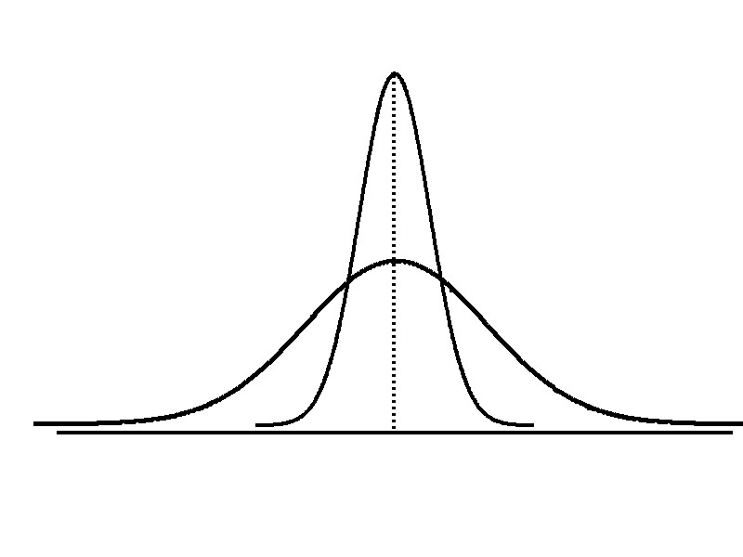
Measures of Variation
Variation
Range
Variance
Standard Deviation
Coefficient of Variation
Measures of variation give information on the spread or variability or dispersion of the data values.
Same center,
different variation

Slide 96
Measures of Variation: The Range
Simplest measure of variation
Difference between the largest and the smallest values:
Range = X_{largest} – X_{smallest}
Example:
0 1 2 3 4 5 6 7 8 9 10 11 12 13 14
Range = 13 - 1 = 12

Slide 97
Measures of Variation: Why The Range Can Be Misleading
Ignores the way in which data are distributed
Sensitive to outliers
7 8 9 10 11 12
7 8 9 10 11 12
Range = 12 - 7 = 5
Range = 12 - 7 = 5
1,1,1,1,1,1,1,1,1,1,1,2,2,2,2,2,2,2,2,3,3,3,3,4,5
Range = 5 - 1 = 4
1,1,1,1,1,1,1,1,1,1,1,2,2,2,2,2,2,2,2,3,3,3,3,4,120
Range = 120 - 1 = 119

Slide 98
Measures of Variation: The Variance
Average (approximately) of squared deviations of values from the mean
Sample variance:
Where
= arithmetic mean
n = sample size
X_{i} = i^{th} value of the variable X

Slide 99
Measures of Variation: The Standard Deviation
Most commonly used measure of variation
Shows variation about the mean
Is the square root of the variance
Has the same units as the original data
Sample standard deviation:

Slide 100
Measures of Variation: Sample Standard Deviation: Calculation Example
Sample Data (X_{i}) : 10 12 14 15 17 18 18 24
n = 8 Mean = X = 16
A measure of the “average” scatter around the mean

Slide 101
Measures of Variation: Comparing Standard Deviations
Data A
Mean = 15.5
S = 3.338
11 12 13 14 15 16 17 18 19 20 21
Data B
Mean = 15.5
S = 0.926
11 12 13 14 15 16 17 18 19 20 21
Data C
Mean = 15.5
S = 4.570
11 12 13 14 15 16 17 18 19 20 21

Slide 102
Measures of Variation: Comparing Standard Deviations
Smaller standard deviation
Larger standard deviation

Slide 103
Standard Deviation for Grouped Data-Example
Frequency Distribution of Return on Investment of Mutual Funds
Return on Investment | Number of Mutual Funds
5-10 10-15 15-20 20-25 25-30 Total | 10 12 16 14 8 60

Slide 104
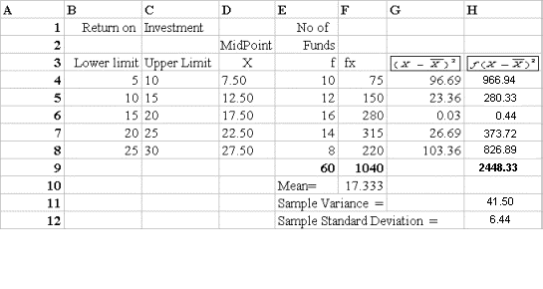
Solution for the Example

Slide 105
Measures of Variation: Summary Characteristics
The more the data are spread out, the greater the range, variance, and standard deviation.
The more the data are concentrated, the smaller the range, variance, and standard deviation.
If the values are all the same (no variation), all these measures will be zero.
None of these measures are ever negative.

Slide 106
Measures of Variation: The Coefficient of Variation
Measures relative variation
Always in percentage (%)
Shows variation relative to mean
Can be used to compare the variability of two or more sets of data measured in different units

Slide 107
Measures of Variation: Comparing Coefficients of Variation
Stock A:
Average price last year = $50
Standard deviation = $5
Stock B:
Average price last year = $100
Standard deviation = $5
Both stocks have the same standard deviation, but stock B is less variable relative to its price

Slide 108
Quartile Measures
Quartiles split the ranked data into 4 segments with an equal number of values per segment
25%
25%
25%
25%
Q1
Q2
Q3
The first quartile, Q₁, is the value for which 25% of the observations are smaller and 75% are larger
Q₂ is the same as the median (50% of the observations are smaller and 50% are larger)
Only 25% of the observations are greater than the third quartile

Slide 109
Quartile Measures Calculating The Quartiles: Example
Sample Data in Ordered Array: 11 12 13 16 16 17 18 21 22
(n = 9)
Q₁ is in the (9+1)/4 = 2.5 position of the ranked data,
so Q₁ = (12+13)/2 = 12.5
Q₂ is in the (9+1)/2 = 5th position of the ranked data,
so Q₂ = median = 16
Q₃ is in the 3(9+1)/4 = 7.5 position of the ranked data,
so Q₃ = (18+21)/2 = 19.5
Q₁ and Q₃ are measures of non-central location
Q₂ = median, is a measure of central tendency

Slide 110
Quartile Measures: The Interquartile Range (IQR)
The IQR is Q₃ – Q₁ and measures the spread in the middle 50% of the data
The IQR is also called the midspread because it covers the middle 50% of the data
The IQR is a measure of variability that is not influenced by outliers or extreme values
Measures like Q₁, Q₃, and IQR that are not influenced by outliers are called resistant measures

Slide 111
Distribution Shape
The shape of the distribution is said to be symmetric if the observations are balanced, or evenly distributed, about the center.

Slide 112
Distribution Shape
(continued)
The shape of the distribution is said to be skewed if the observations are not symmetrically distributed around the center.
A positively skewed distribution (skewed to the right) has a tail that extends to the right in the direction of positive values.
A negatively skewed distribution (skewed to the left) has a tail that extends to the left in the direction of negative values.

Slide 113
Shape of a Distribution
Describes how data are distributed
Measures of shape
Symmetric or skewed
Left-Skewed
Symmetric
Right-Skewed
Mean < Median
Mean = Median
Median < Mean

Slide 114
Methods for Determining Outliers
An outlier is a measurement that is unusually large or small relative to the other values.
Three possible causes:
Observation, recording or data entry error
Item is from a different population
A rare, chance event

Slide 115
Locating Extreme Outliers: Z-Score
To compute the Z-score of a data value, subtract the mean and divide by the standard deviation.
The Z-score is the number of standard deviations a data value is from the mean.
A data value is considered an extreme outlier if its Z-score is less than -3.0 or greater than +3.0.
The larger the absolute value of the Z-score, the farther the data value is from the mean.

Slide 116
Locating Extreme Outliers: Z-Score
where X represents the data value
X is the sample mean
S is the sample standard deviation

Slide 117
Locating Extreme Outliers: Z-Score
Suppose the mean math score is 490, with a standard deviation of 100.
Compute the Z-score for a test score of 620.
A score of 620 is 1.3 standard deviations above the mean and would not be considered an outlier.

Slide 118
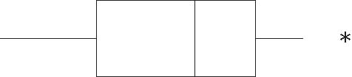
Boxplot
The box plot is a graph representing information about certain percentiles for a data set and can be used to identify outliers. It
 plots the five-number summary
 shows the spread of the data
 detects outliers

Slide 119
The Five-number summary
Min value Q_{L} Median Q_{U} Max value
Lower Quartile
(Q_{L})
Median
Upper Quartile
(Q_{U})
Minimum Value
Maximum Value

Slide 120
Boxplot Construction
To construct a Boxplot
Draw a horizontal scale.
Construct a rectangular box whose left (or lower) edge is at the lower quartile and whose right (or upper) edge is at the upper quartile (the box width = IQR). Draw a vertical line segment inside the box at the location of the median.
Extend horizontal line segments from each end of the box to the smallest and largest observations in the data set. (These lines are called whiskers.)

Slide 121
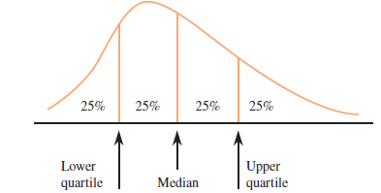
Quartiles and the Interquartile Range
Lower quartile (Q_{L}) = median of the lower half of the data set.
Upper Quartile (Q_{U}) = median of the upper half of the data set.
Interquartile Range (IQR)= upper quartile – lower quartile = Q_{U} – Q_{L}
IQR= Q_{U} - Q_{L}

Slide 122
Outliers
• An observations is an outlier if it is more than 1.5×IQR away from the closest end of the box (less than the lower quartile minus 1.5×IQR or more than the upper quartile plus 1.5×IQR.
Outlier < Lower inner fence = Q_{L} – 1.5×IQR
Outlier > Upper inner fence = Q_{U} + 1.5×IQR
• An outlier is extreme if it is more than 3×IQR from the closest end of the box, and it is mild otherwise.
Outlier < Lower inner fence = Q_{L} – 3×IQR
Outlier > Upper inner fence = Q_{U} + 3×IQR

Slide 123
Example: Consider the ages of the 79 students.
IQR = 22 – 19 = 3
Lower quartile – 3×IQR= 10 Lower quartile – 1.5×IQR=14.5
Upper quartile + 3×IQR = 31 Upper quartile + 1.5×IQR = 26.5
17 18 18 18 18 18 19 19 19 19
19 19 19 19 19 19 19 19 19 19
19 19 19 19 19 19 20 20 20 20
20 20 20 20 20 20 21 21 21 21
21 21 21 21 21 21 21 21 21 21
22 22 22 22 22 22 22 22 22 22
22 23 23 23 23 23 23 24 24 24
25 26 28 28 30 37 38 44 47
Lower
Quartile
Median
Upper
Quartile
Moderate
Outliers
Extreme
Outliers

Slide 124
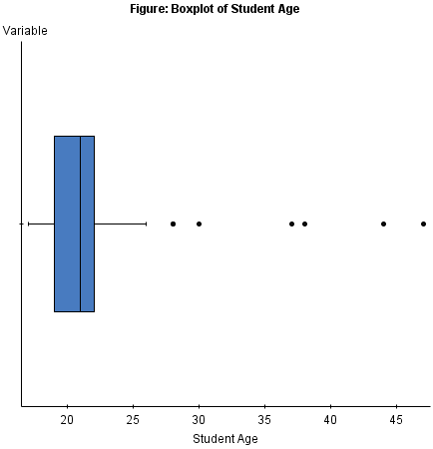
Smallest data
value that isn’t
an outlier
Largest data
value that isn’t
an outlier
Mild
Outliers
Extreme
Outliers

Slide 125
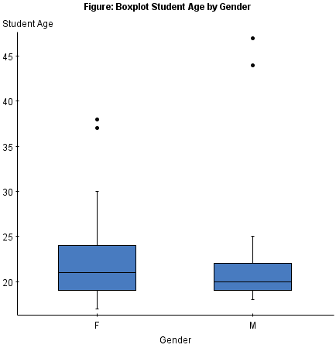
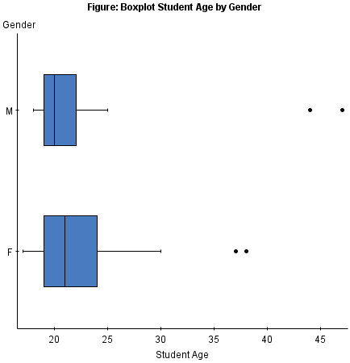
Comparative Boxplot Example
By putting boxplots of two separate groups or subgroups we can compare their distributional behaviors.

Slide 126
Examples
• Which of the following is not true with regards to finding the median of a data set?
a. The first step is to order the data set from smallest to largest.
b. If n is even the sample median is the average of the middle two values in the ordered list.
c. Any repeated values should be removed from the data set prior to determining the median.
d. If n is odd, the sample median is the single middle value of the ordered list.

Slide 127
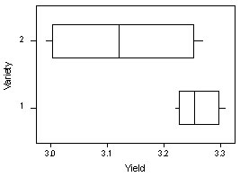
• Which of the following is a correct interpretation of the yield for variety 1 and 2 from the boxplot below?
a. The yield is generally greater for variety 2.
b. The yields appear to be approximately the same for
variety 1 and 2.
c. The data are more variable for variety 1 than variety 2.
d. It is not reasonable to conclude that the populations
(variety 1 and variety 2) have equal variances.

Slide 128
• A sample of 10 individuals was taken at a college football game and the number of games they attend a year was recorded. The descriptive statistics for the data are given as follows.
What is the five-number summary for this data?
a. 1, 2, 4, 5.25, 7
b. 1, 2, 3.9, 5.25, 7
c. 10, 3.9, 0.605, 1.912, 1.0
d. 1, –0.605, 3.9, 0.605, 7

Slide 129
• Which of the following is not affected by extreme outliers?
a. Variance
b. Median
c. Range
d. Mean

Slide 130
• Which of the following is a not a measure of variability?
a. Interquartile Range
b. Standard deviation
c. Population variance
d. Proportion

Slide 131
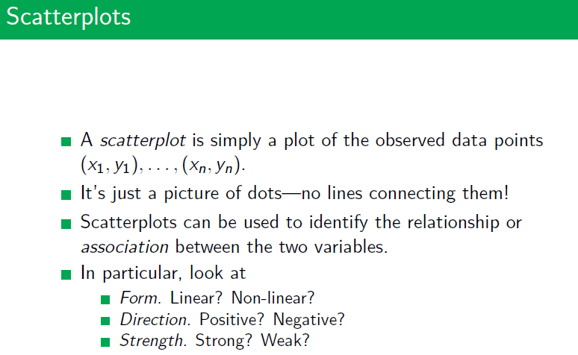

Slide 132
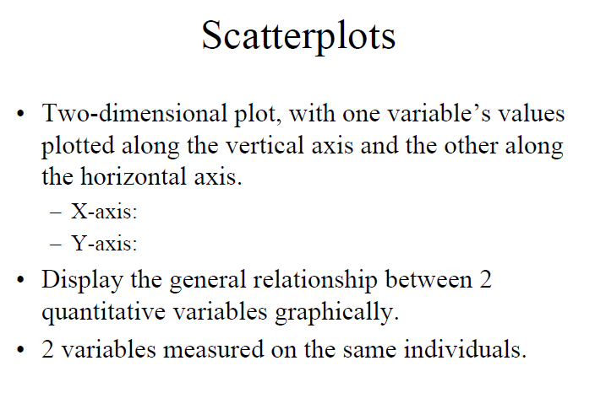
Scatterplots

Slide 133
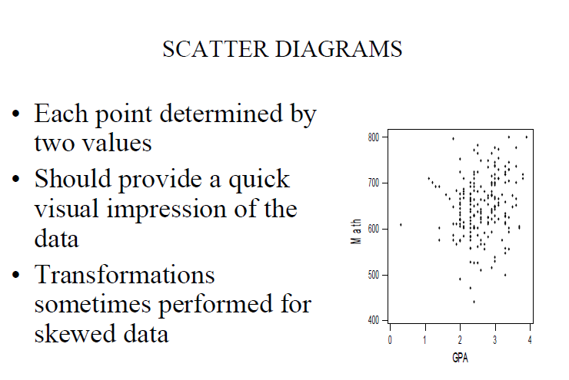

Slide 134
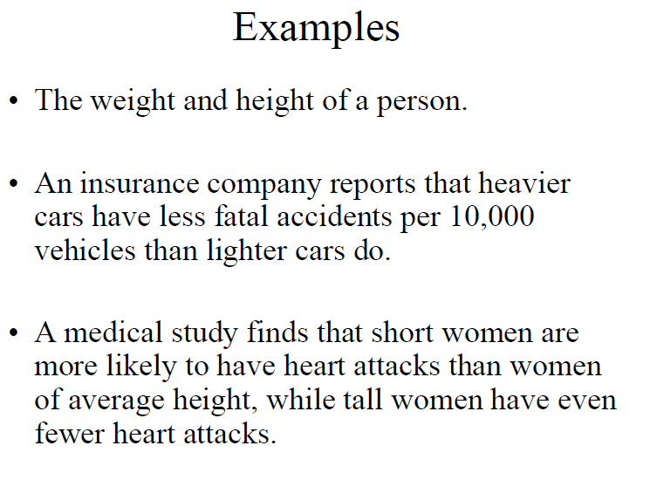

Slide 135
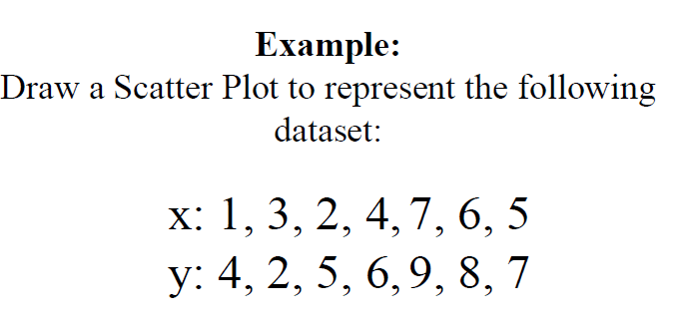
Example

Slide 136
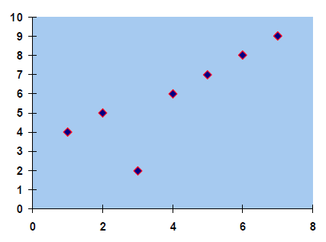
y
x
Figure: Scatterplot between x and y variables

Slide 137
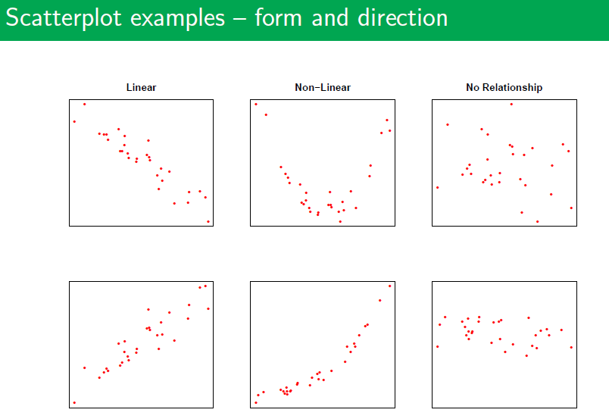

Slide 138
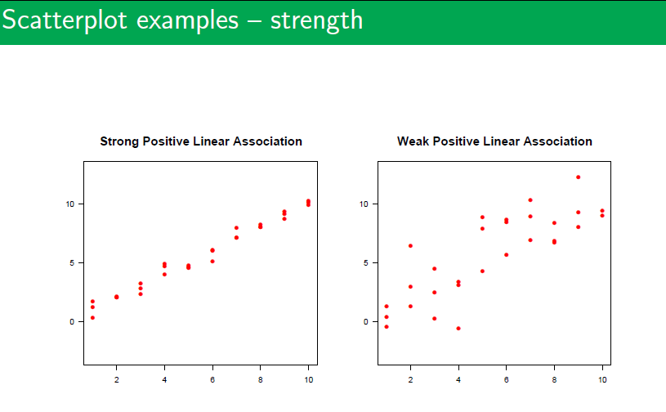

Slide 139
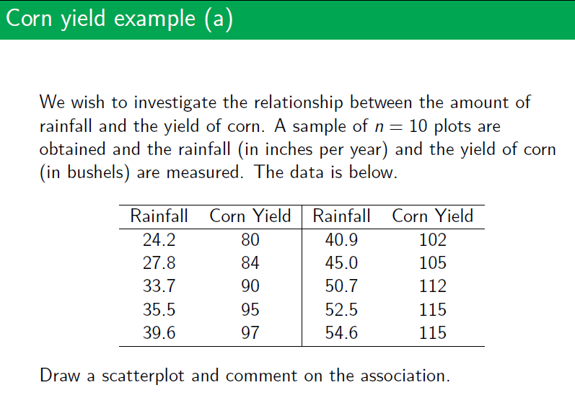

Slide 140
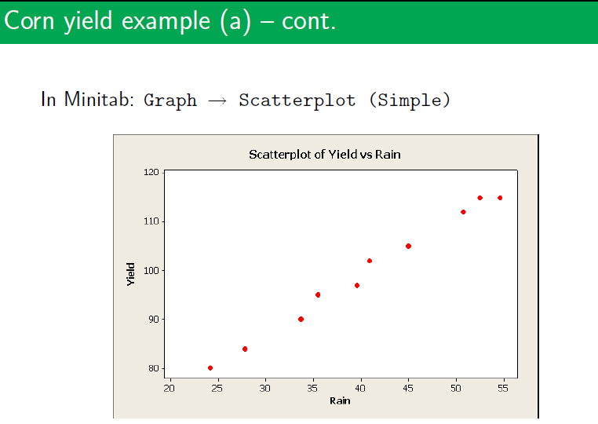

Slide 141
Correlation:
It measures the strength of a certain type of relationship between two measurement variables.

Slide 142
The Pearson Correlation Coefficient
• A measure of the strength of the linear relationship between the two variables is called the Pearson correlation coefficient.
• The Pearson sample correlation coefficient is represented by r.
Indicator of how closely the values fall to a straight line.
Measures linear relationships only; that is, it measures how close the individual points in a scatterplot are to a straight line.

Slide 143
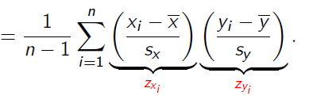
The Pearson sample correlation coefficient ( r ) is calculated by the following formula:

Slide 144
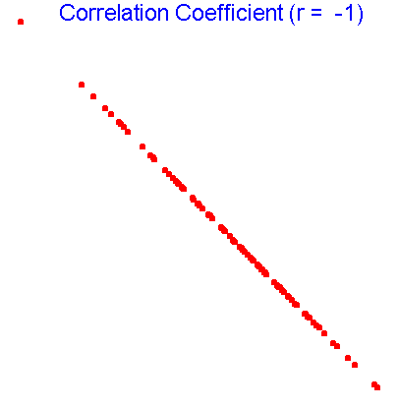
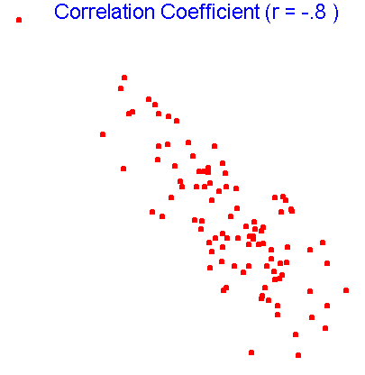
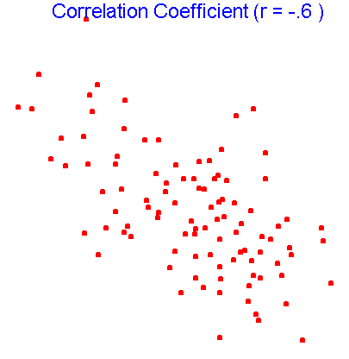
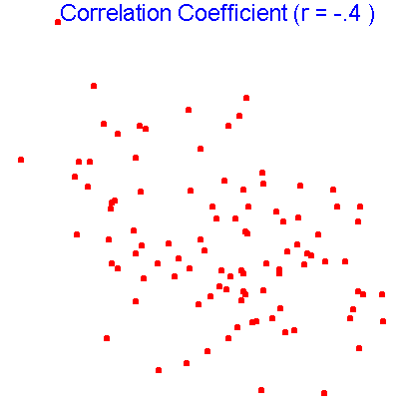
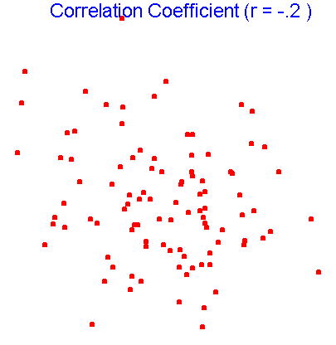
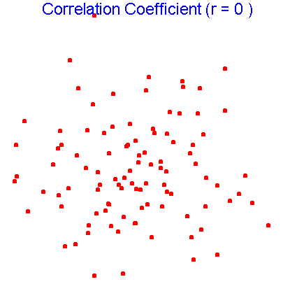
Some Scatterplots and Correlation Coefficients

Slide 145
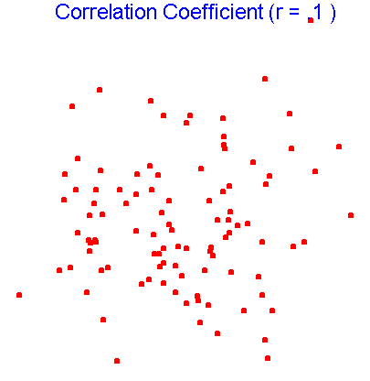
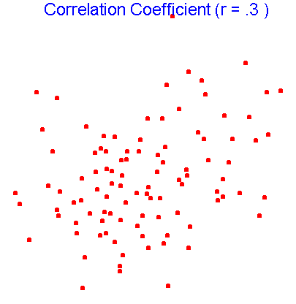
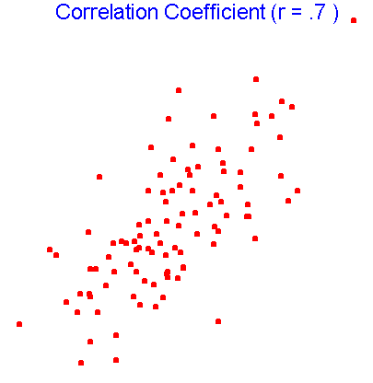
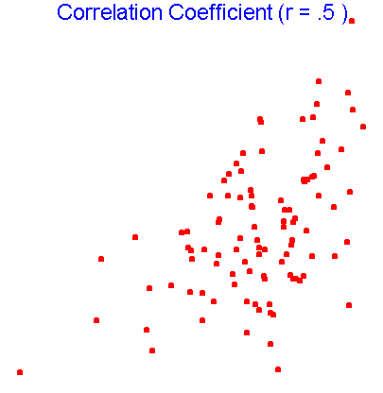
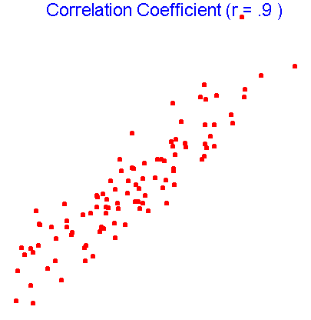
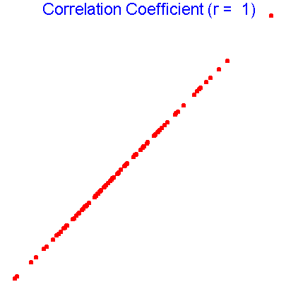
Some Scatterplots and Correlation Coefficients

Slide 146
Properties of r
1. The value of r is between -1 and 1. That is,
-1 ≤ r ≤ 1
2. Correlation of +1 indicates a perfect linear relationship between the two variables; as one increases, so does the other. All individuals fall on the same straight line.
3. Correlation of –1 also indicates a perfect linear relationship between the two variables; however, as one increases, the other decreases.
4. Correlation of zero could indicate no linear relationship between the two variables, or that the best straight line through the data on a scatterplot is exactly horizontal.

Slide 147
5. A positive correlation indicates that the variables increase together.
6. A negative correlation indicates that as one variable increases, the other decreases.
7. Correlations are unaffected if the units of measurement are changed. For example, the correlation between weight and height remains the same regardless of whether height is expressed in inches, feet or millimeters (as long as it isn’t rounded off).
8. The value of r is a measure of the extent to which x and y are linearly related.

Slide 148
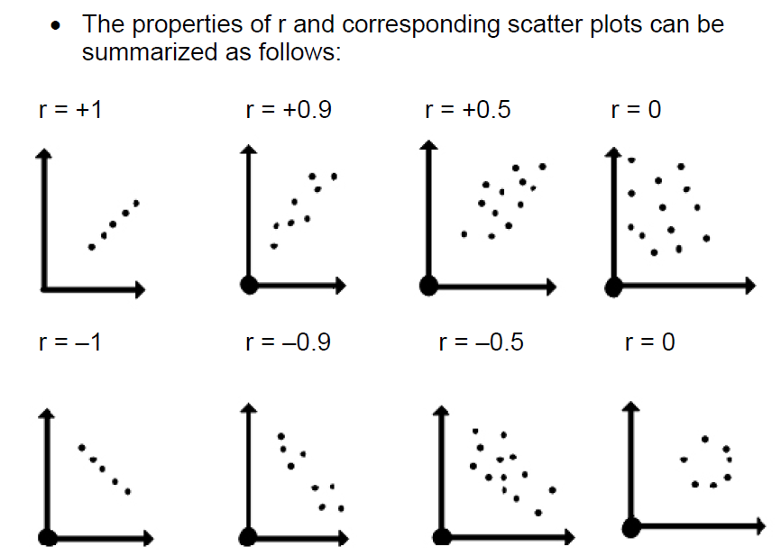

Slide 149

The following figure provides a good indication of the qualitative description of the strength of the linear relationship.

Slide 150
Interpreting Covariance
Covariance between two variables:
cov(X,Y) > 0 X and Y tend to move in the same direction
cov(X,Y) < 0 X and Y tend to move in opposite directions
cov(X,Y) = 0 X and Y are independent
The covariance has a major flaw:
It is not possible to determine the relative strength of the relationship from the size of the covariance

Slide 151
Coefficient of Correlation
Measures the relative strength of the linear relationship between two numerical variables
Sample coefficient of correlation:
where

Slide 152
Features of the Coefficient of Correlation
The population coefficient of correlation is referred as ρ.
The sample coefficient of correlation is referred to as r.
Either ρ or r have the following features:
Unit free
Ranges between –1 and 1
The closer to –1, the stronger the negative linear relationship
The closer to 1, the stronger the positive linear relationship
The closer to 0, the weaker the linear relationship

Slide 153
Scatter Plots of Sample Data with Various Coefficients of Correlation
Y
Y
X
X
r = -1
r = -.6
Y
Y
Y
X
X
X
r = +1
r = +.3
r = 0

Slide 154
Basics of Probability
Classical probability
Frequency probability
Axiomatic probability
Historical development: Classical, Frequency Axiomatic.
The Axiomatic definition encompasses the Classical and Frequency definitions of probability

Slide 155
Classical Probability
Definition: If a random experiment (process with an uncertain outcome) can result in n mutually exclusive and equally likely outcomes, and if nA of these outcomes has an attribute A, then the probability of A is the fraction (nA/n).

Slide 156
Classical Probability
Axiom A Basic assumption in the definition of classical probability is that n is a finite number; that is, there is only a finite number of possible outcomes. If there is an infinite number of possible outcomes, the probability of an outcome is not defined in the classical sense.

Slide 157
Frequency Probability

Slide 158
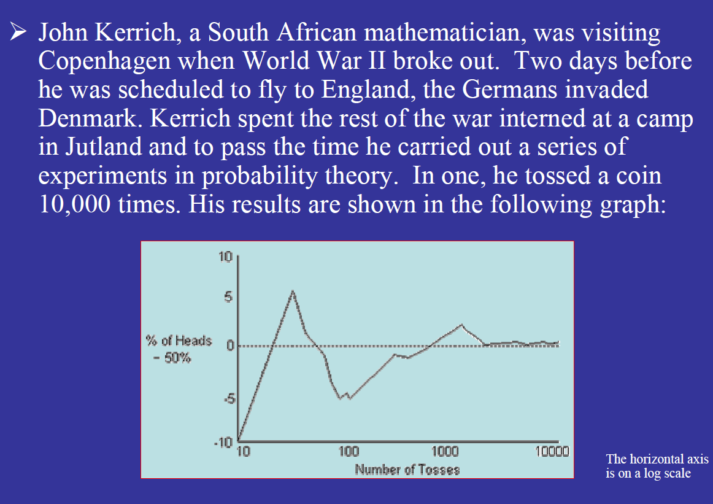
Frequency Probability

Slide 159
Frequency Probability

Slide 160
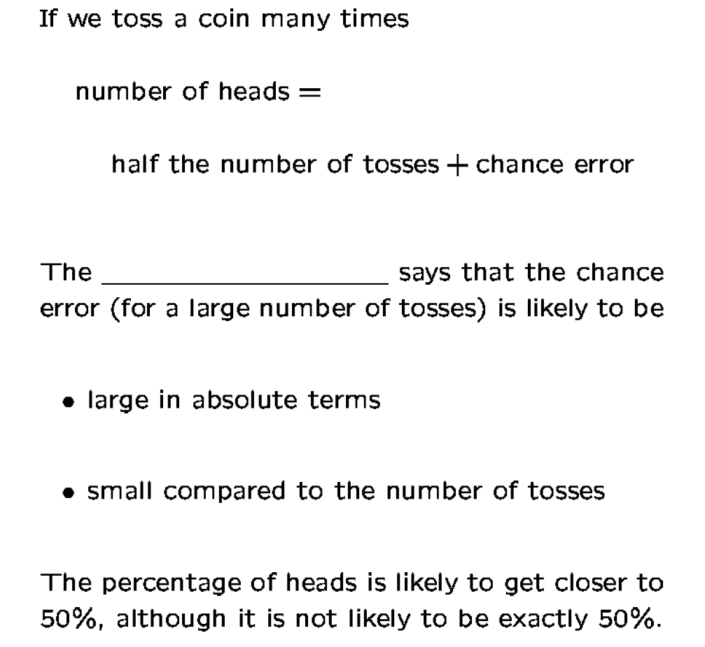
Frequency Probability

Slide 161
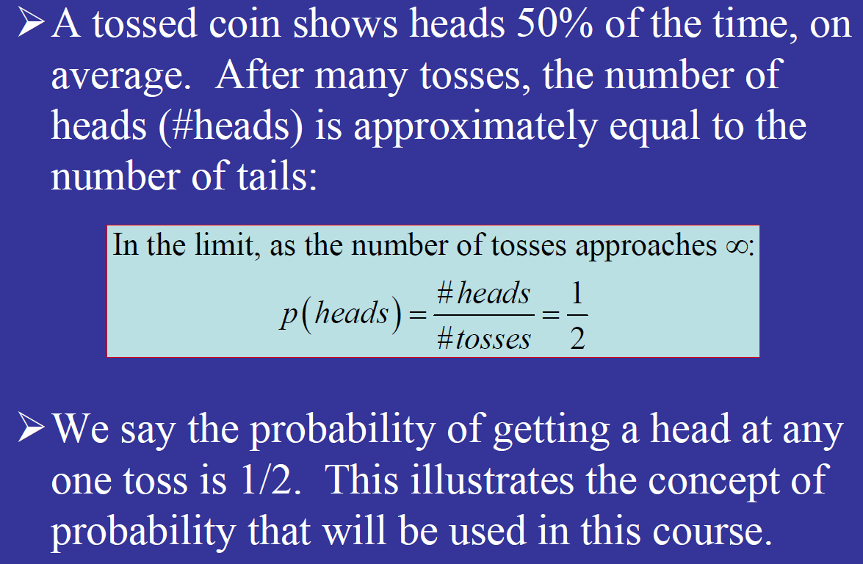
Frequency Probability

Slide 162
Axiomatic Probability

Slide 163
Axiomatic Probability

Slide 164
Basic Definitions
Experiment: act or process that leads to a single outcome that cannot be predicted with certainty
Examples:
1. Toss a coin
2. Draw 1 card from a standard deck of cards
3. Arrival time of flight from Atlanta to RDU

Slide 165
Basic Definitions (cont.)
Sample space: all possible outcomes of an experiment. Denoted by S
Event: any subset of the sample space S;
typically denoted A, B, C, etc.
Simple event: event with only 1 outcome
Null event: the empty set Φ
Certain event: S

Slide 166
Examples
1. Toss a coin once
S = {H, T}; A = {H}, B = {T} simple events
2. Toss a die once; count dots on upper face
S = {1, 2, 3, 4, 5, 6}
A=even # of dots on upper face={2, 4, 6}
B=3 or fewer dots on upper face={1, 2, 3}

Slide 167
Laws of Probability
Law

Slide 168
Laws of Probability (cont.)
3. P(A’ ) = 1 - P(A)
For an event A, A’ is the complement of A; A’ is everything in S that is not in A.
S
A'
A

Slide 169
Unions and Intersections
Union
S
A∩Β
A
B
A∪Β

Slide 170
Mutually Exclusive Events
Mutually exclusive events-no outcomes from S in common
A ∩ Β = ∅
S
A
B

Slide 171
Laws of Probability (cont.)
Addition Rule for Disjoint Events:
4. If A and B are disjoint events, then
P(A ∪ B) = P(A) + P(B)

Slide 172
Laws of Probability (cont.)
General Addition Rule
5. For any two events A and B
P(A ∪ B) = P(A) + P(B) – P(A ∩ B)

Slide 173
P(A∪B)=P(A) + P(B) - P(A ∩ B)
S
A∩Β
A
B

Slide 174
Example: toss a fair die once
S = {1, 2, 3, 4, 5, 6}
A = even # appears = {2, 4, 6}
B = 3 or fewer = {1, 2, 3}
P(A ∪ B) = P(A) + P(B) - P(A ∩ B)
=P({2, 4, 6}) + P({1, 2, 3}) - P({2})
= 3/6 + 3/6 - 1/6 = 5/6

Slide 175
Laws of Probability: Summary
1. 0 ≤ P(A) ≤ 1 for any event A
2. P(∅) = 0, P(S) = 1
3. P(A’) = 1 – P(A)
4. If A and B are disjoint events, then
P(A ∪ B) = P(A) + P(B)
5. For any two events A and B,
P(A ∪ B) = P(A) + P(B) – P(A ∩ B)

Slide 176
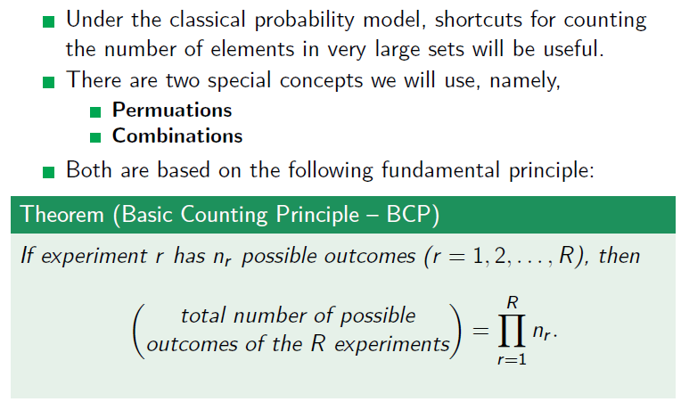
Counting rules

Slide 177
Permutations
A B C D E
How many ways can we choose 2 letters from the above 5, without replacement, when the order in which we choose the letters is important?
5 × 4 = 20

Slide 178
Permutations (cont.)

Slide 179
Combinations
A B C D E
How many ways can we choose 2 letters from the above 5, without replacement, when the order in which we choose the letters is not important?
5 × 4 = 20 when order important
Divide by 2: (5 × 4)/2 = 10 ways

Slide 180
Combinations (cont.)

Slide 181
Multiplication rule
for two steps experiment
If an experiment consists of two steps and if n₁ is the possible outcomes of the first step and n₂ is the possible outcomes of second step, then the total number of possible outcomes will be n₁ × n₂ ordered pairs. That is each outcome will contain two elements one from each step.
Example: Throw a balanced die and a fair coin simultaneously. Find the total number of sample points of the experiment.

Slide 182
Multiplication rule
for k steps experiment
(product rule for k-tuples)
If an experiment consists of k steps and let n₁, n₂,…,n_{k} be the possible outcome of the 1st, 2nd, …,k^{th} step, then the total number of outcomes of the experiment will be
n₁ × n₂ × … × n_{k} and each outcome of the experiment will contain k elements one from each step.

Slide 183
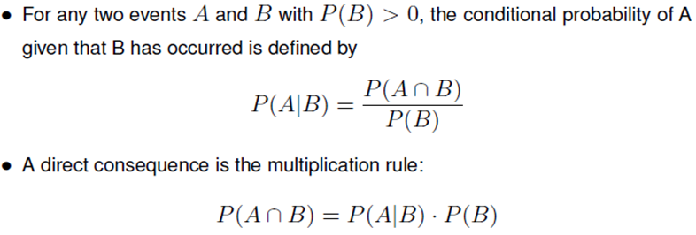
Conditional Probability

Slide 184
In this section, we discuss one of the most fundamental concepts in probability theory. Here is the question: as you obtain additional information, how should you update probabilities of events? For example, suppose that in a certain city, 23 percent of the days are rainy. Thus, if you pick a random day, the probability that it rains that day is 23 percent:
P(R)=0.23,where R is the event that it rains on the randomly chosen day.
Now suppose that I pick a random day, but I also tell you that it is cloudy on the chosen day. Now that you have this extra piece of information, how do you update the chance that it rains on that day? In other words, what is the probability that it rains given that it is cloudy? If C is the event that it is cloudy, then we write this as P(R|C) , the conditional probability of R given that C has occurred. It is reasonable to assume that in this example, P(R|C) should be larger than the original P(R) , which is called the prior probability of R . But what exactly should P(R|C) be?

Slide 185
Here is the intuition behind the formula. When we know that B has occurred, every outcome that is outside B should be discarded. Thus, our sample space is reduced to the set B , Now the only way that A can happen is when the outcome belongs to the set A∩B . We divide P(A∩B) by P(B) , so that the conditional probability of the new sample space becomes 1 , i.e., P(B|B)=P(B∩B)/P(B) =1 .
Note that conditional probability of P(A|B) is undefined when P(B)=0 . That is okay because if P(B)=0 , it means that the event B never occurs so it does not make sense to talk about the probability of A given B .

Slide 186
Examples – Conditional Probability
.10/.25

Slide 187
Example
Suppose that of all individuals buying a certain digital
camera, 60% include an optional memory card in
their purchase, 40% include an extra battery, and
30% include both a card and battery. Consider
randomly selecting a buyer and let A = {memory card purchased} and B = {battery purchased}.
Then P(A) = .60, P(B) = .40,
P(both purchased) = P(A ∩ B) = .30

Slide 188
Example (Contd…)
Given that the selected individual purchased an extra
battery, the probability that an optional card was
also purchased is
That is, of all those purchasing an extra battery, 75% purchased an optional memory card.

Slide 191

The Multiplication Rule for P(A ∩ B)
This rule is important because it is often the case that P(A ∩ B) is desired, whereas both P(B) and
can be specified from the problem description.

Slide 192
A box contains 6 white balls and 4 red balls. We randomly (and without replacement) draw two balls from the box. What is the probability that the second ball selected is red?

Slide 193
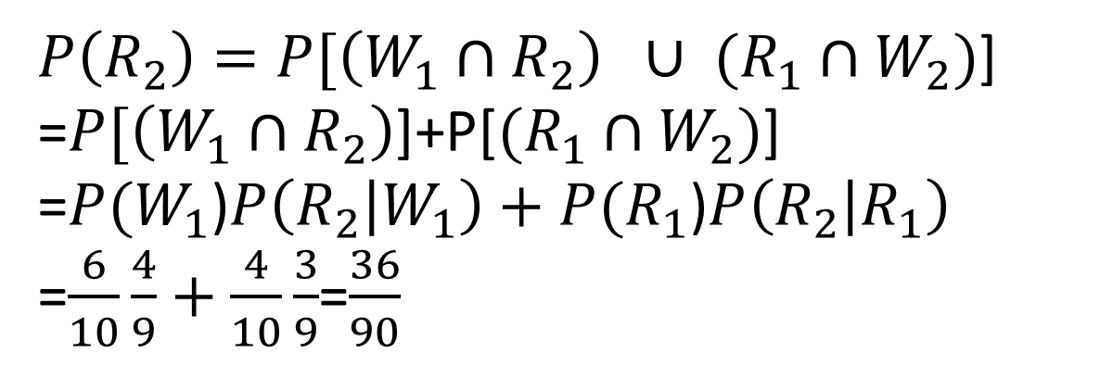

Slide 194
Law of Total Probability

Slide 195
Law of Total Probability and Bayes Theorem

Slide 196
General Case: Bayes Theorem

Slide 197
Bayes Theory: General Case

Slide 198
The Law of Total Probability- Example
₂₋₁₉₈
Event U: Stock market will go up in the next year
Event W: Economy will do well in the next year

Slide 199
Bayes’ Theorem
₂₋₁₉₉
Bayes’ theorem enables you, knowing just a little more than the probability of A given B, to find the probability of B given A.
Based on the definition of conditional probability and the law of total probability.
Applying the law of total
probability to the denominator
Applying the definition of
conditional probability throughout

Slide 200
Bayes Theory

Slide 201
Bayes Theory

Slide 202
Bayes Theory
An Example Let's say we want to know how a change in interest rates would affect the value of a stock market index. All major stock market indexes have a plethora of historical data available so you should have no problem finding the outcomes for these events with a little bit of research. For our example we will use the data below to find out how a stock market index will react to a rise in interest rates.

Slide 203
Bayes Theory

Slide 204
Bayes Theory

Slide 205
Bayes Theory
In the table you can see that out of 2000 observations, 1150 instances showed the stock index decreased. This is the prior probability based on historical data, which in this example is 57.5% (1150/2000). This probability doesn't take into account any information about interest rates, and is the one we wish to update.
After updating this prior probability with information that interest rates have risen leads us to update the probability of the stock market decreasing from 57.5% to 95%. 95% is the posterior probability.

Slide 206
Example (False positive paradox )
A certain disease affects about 1 out of 10,000 people. There is a test to check whether the person has the disease. The test is quite accurate. In particular, we know that
•the probability that the test result is positive (suggesting the person has the disease), given that the person does not have the disease, is only 2 percent;
•the probability that the test result is negative (suggesting the person does not have the disease), given that the person has the disease, is only 1 percent.
A random person gets tested for the disease and the result comes back positive. What is the probability that the person has the disease?

Slide 207
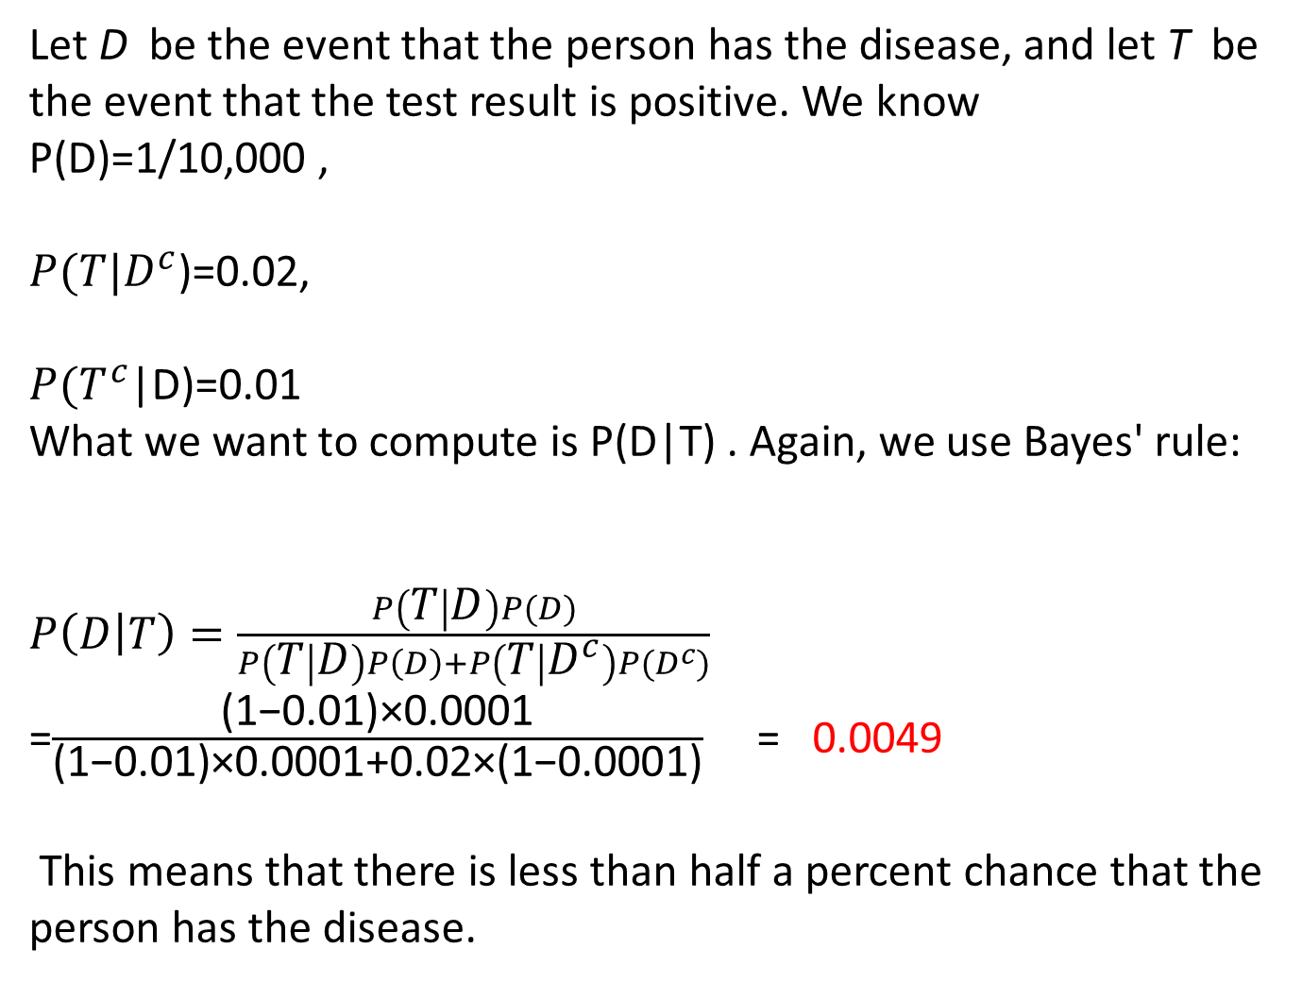

Slide 208
Bayes’ Theorem - Example
₂₋₂₀₈
A medical test for a rare disease (affecting 0.1% of the population [ ]) is imperfect:
When administered to an ill person, the test will indicate so with probability 0.92 [ ]
The event is a false negative
When administered to a person who is not ill, the test will erroneously give a positive result (false positive) with probability 0.04 [ ]
The event is a false positive. .

Slide 209
Example (continued)
₂₋₂₀₉

Slide 210
Example (Tree Diagram)
Prior
Probabilities
Conditional
Probabilities
Joint
Probabilities

Slide 211
Bayes’ Theorem Extended
Given a partition of events B₁,B₂ ,...,B_{n}:
Applying the law of total
probability to the denominator
Applying the definition of
conditional probability throughout

Slide 212
Bayes’ Theorem Extended - Example
An economist believes that during periods of high economic growth, the U.S. dollar appreciates with probability 0.70; in periods of moderate economic growth, the dollar appreciates with probability 0.40; and during periods of low economic growth, the dollar appreciates with probability 0.20.
During any period of time, the probability of high economic growth is 0.30, the probability of moderate economic growth is 0.50, and the probability of low economic growth is 0.50.
Suppose the dollar has been appreciating during the present period. What is the probability we are experiencing a period of high economic growth?
Partition:
H - High growth P(H) = 0.30
M - Moderate growth P(M) = 0.50
L - Low growth P(L) = 0.20

Slide 213
Example (continued)
₂₋₂₁₃

Slide 214
Example (Tree Diagram)
₂₋₂₁₄
Prior
Probabilities
Conditional
Probabilities
Joint
Probabilities

Slide 215
Another Example
In order to detect whether a suspect is lying, police sometimes use polygraph. Let A={polygraph indicates lying} and B={the suspect is lying}. If the suspect is lying, there is a 88% chance of detecting it; if the suspect is telling the truth, 86% of time the polygraph will confirm it. We assume that 1% of the time the suspects lie. If the result of polygraph shows that the suspect is lying, what is the chance that this person is really lying?

Slide 217
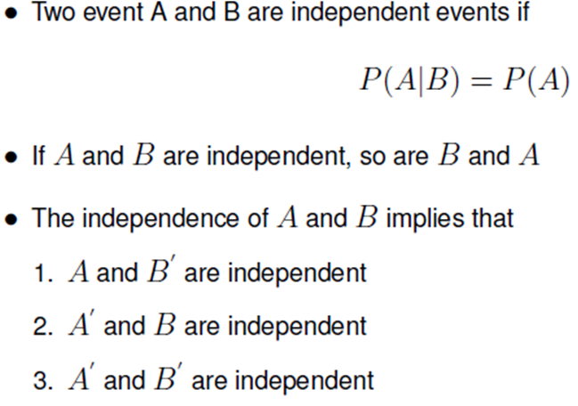
Independence

Slide 218
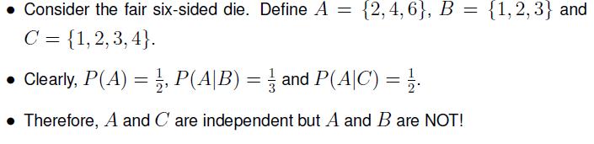
Example

Slide 219
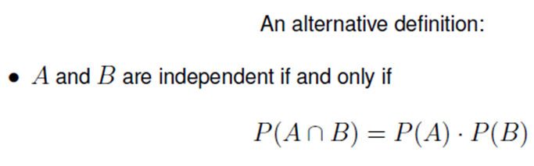

Mutual independence

Slide 220

Definition – Independent Events

Slide 221
Definition – Multiplication Rule for
Independent Outcomes
If two outcomes are independent, the probability that both outcomes occur is the product of the individual outcome probabilities. Denoting the outcomes as A and B, we write
P (A and B) = P (A) ⋅ P (B)

Slide 222

Geometric Distribution
The geometric distribution gives the probability that the first occurrence of success requires k independent trials, each with success probability p. If the probability of success on each trial is p, then the probability that the kth trial (out of k trials) is the first success is
$\operatorname{Pr}\left(X=k\right)={\left(1−p\right)}^{k−1}p,$for k = 1, 2, 3, ....
The above form of the geometric distribution is used for modeling the number of trials up to and including the first success. By contrast, the following form of the geometric distribution is used for modeling the number of failures until the first success:
$\operatorname{Pr}\left(X=k\right)={\left(1−p\right)}^{k}p,$for k = 0, 1, 2, 3, ....

Slide 223
Geometric Distribution (Example)
A newlywed couple plans to have children, and will continue until the first girl. What is the probability that there are zero boys before the first girl, one boy before the first girl, two boys before the first girl, and so on?
A doctor is seeking an anti-depressant for a newly diagnosed patient. Suppose that, of the available anti-depressant drugs, the probability that any particular drug will be effective for a particular patient is p=0.6. What is the probability that the first drug found to be effective for this patient is the first drug tried, the second drug tried, and so on? What is the expected number of drugs that will be tried to find one that is effective?
A patient is waiting for a suitable matching kidney donor for a transplant. If the probability that a randomly selected donor is a suitable match is p=0.1, what is the expected number of donors who will be tested before a matching donor is found?

Slide 224
Geometric Distribution (ASSUMPTION)
The geometric distribution is an appropriate model if the following assumptions are true.
The phenomenon being modelled is a sequence of independent trials.
There are only two possible outcomes for each trial, often designated success or failure.
The probability of success, p, is the same for every trial.

Slide 225

Exponential distribution

Slide 226

Exponential distribution

Slide 227


